Slide 1

Video Games Released in 2022
A presentation for the data science/programming team head.
By: Loai Siwas | loai@hotmail.cl

Slide 2
Introduction
The gaming industry is a rapidly growing market, with revenues expected to reach $196 billion by 2022. As a company, it is essential for us to stay informed on the latest trends and patterns in the industry. This analysis will provide valuable insights on the most popular platforms, genres, developers, and market share among competitors, which will help inform our future game development and distribution plans.

Slide 3

The Data
the results of the data we have collected on the games produced in 2022.
The data was sourced from a Kaggle: Data Source: https://www.kaggle.com/datasets/mattop/video-games-released-in-2022

Slide 4
Data Shape
The data set we analyzed includes 987 observations and 7 columns, as outlined below:
Month | Day | Title | Platform(s) | Genre(s) | Developer(s) | Publisher(s)
Text | Number | Text | Text | Text | Text | Text

Slide 5
Summary Statistics
 | Month | Day | Title | Platform(s) | Genre(s) | Developer(s) | Publisher(s)
count | 987 | 987.000000 | 987 | 987 | 987 | 987 | 987
unique | 12 | NaN | 855 | 102 | 251 | 697 | 422
top | JUNE | NaN | Azure Striker Gunvolt 3 | NS | Adventure | Square Enix | Square Enix
freq | 127 | NaN | 4 | 184 | 72 | 13 | 32
mean | NaN | 16.599797 | NaN | NaN | NaN | NaN | NaN
std | NaN | 8.814457 | NaN | NaN | NaN | NaN | NaN
min | NaN | 1.000000 | NaN | NaN | NaN | NaN | NaN
25% | NaN | 10.000000 | NaN | NaN | NaN | NaN | NaN
50% | NaN | 17.000000 | NaN | NaN | NaN | NaN | NaN
75% | NaN | 24.000000 | NaN | NaN | NaN | NaN | NaN
max | NaN | 31.000000 | NaN | NaN | NaN | NaN | NaN

Slide 6
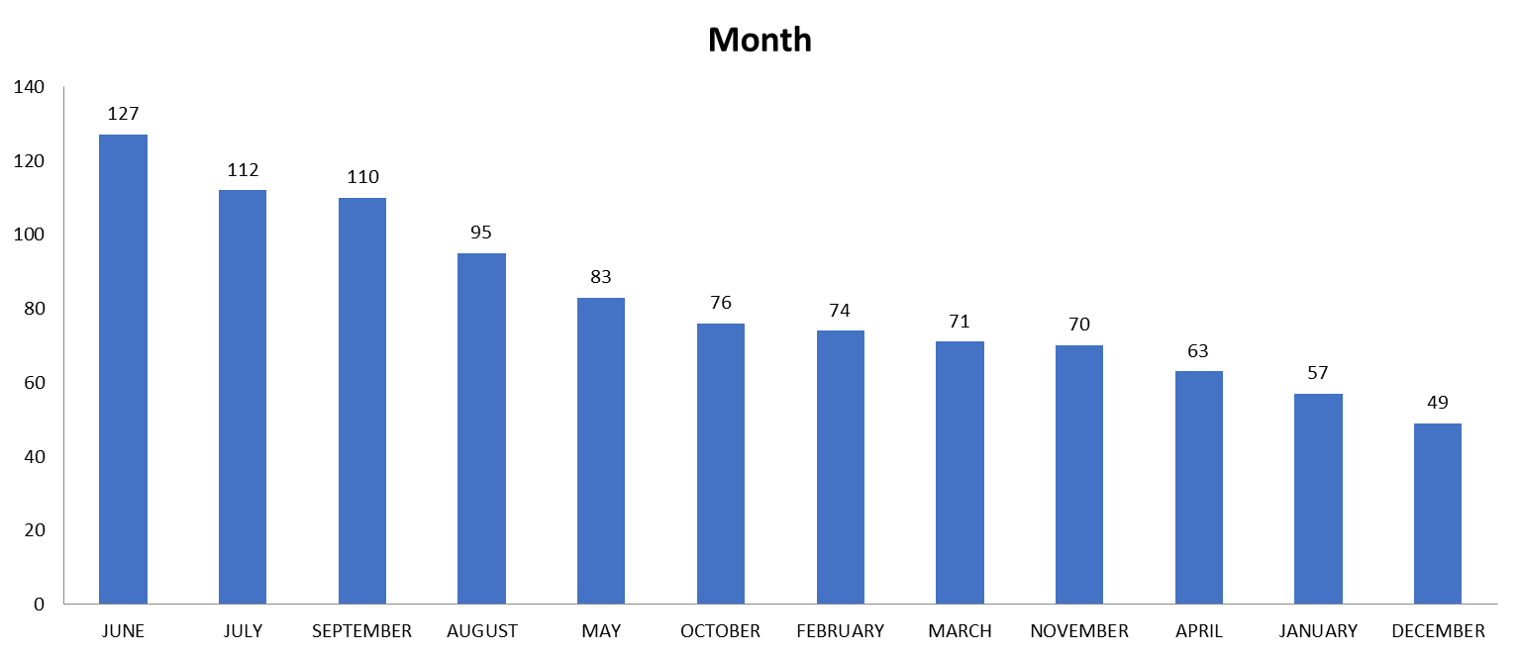
Month

Slide 7
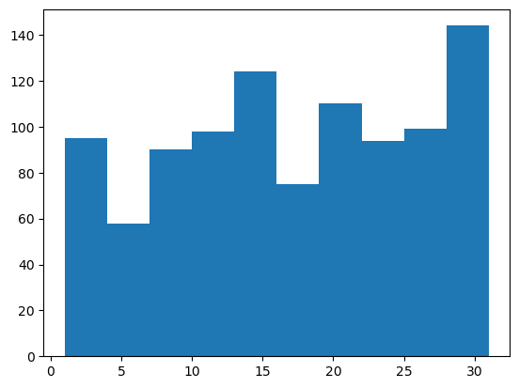
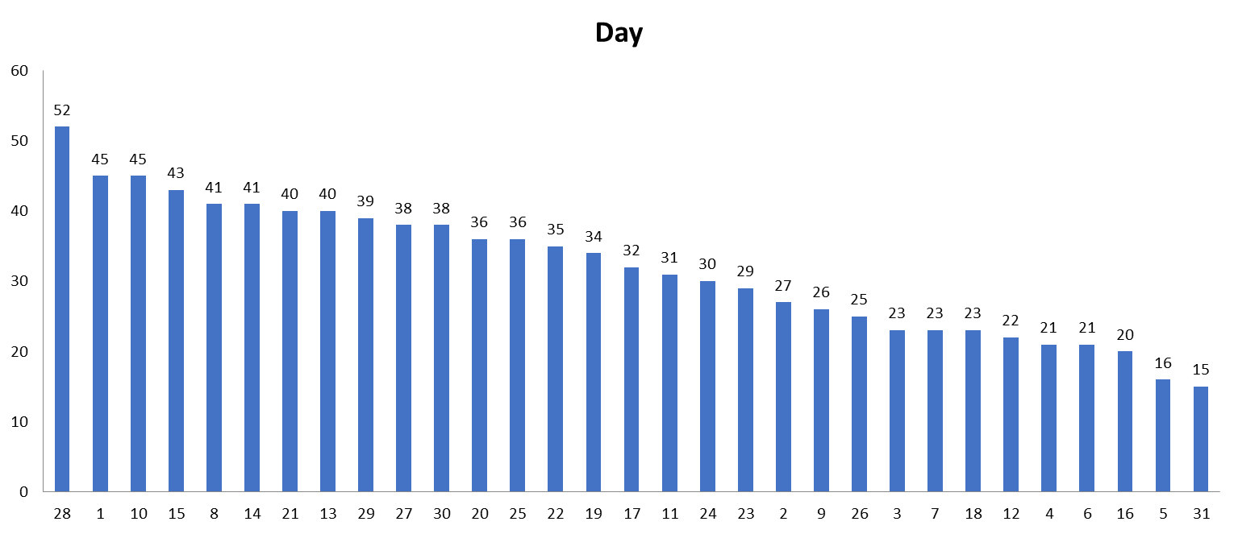
Day

Slide 8
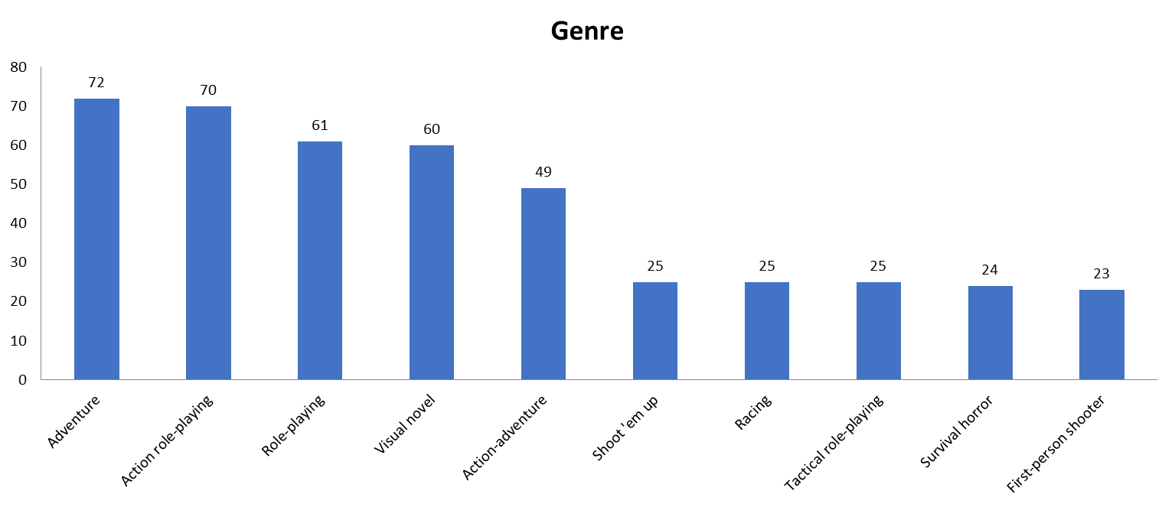
Genre (Top 10)

Slide 9
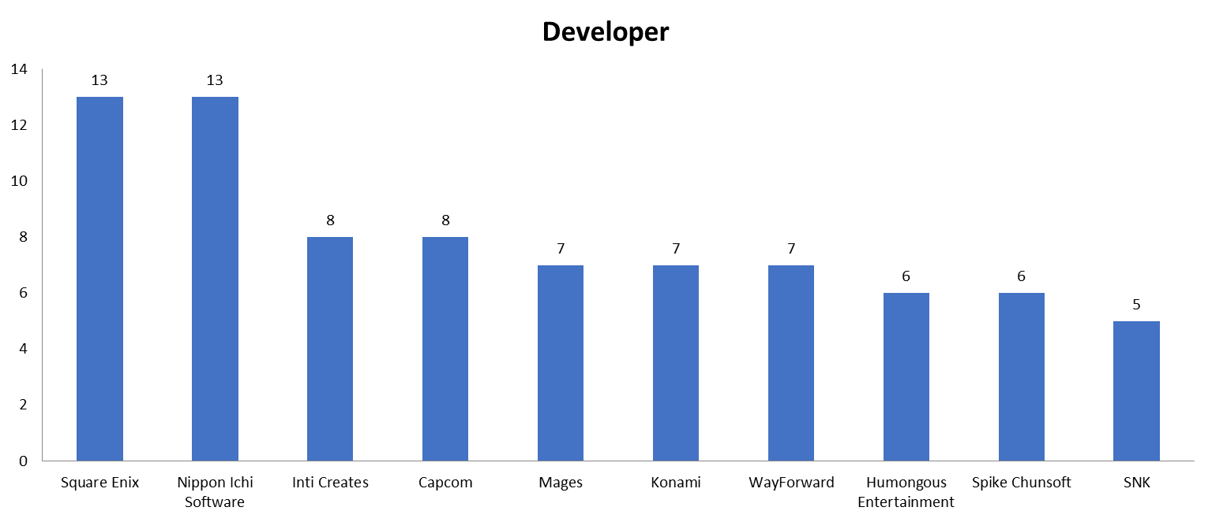
Developer (Top 10)

Slide 10
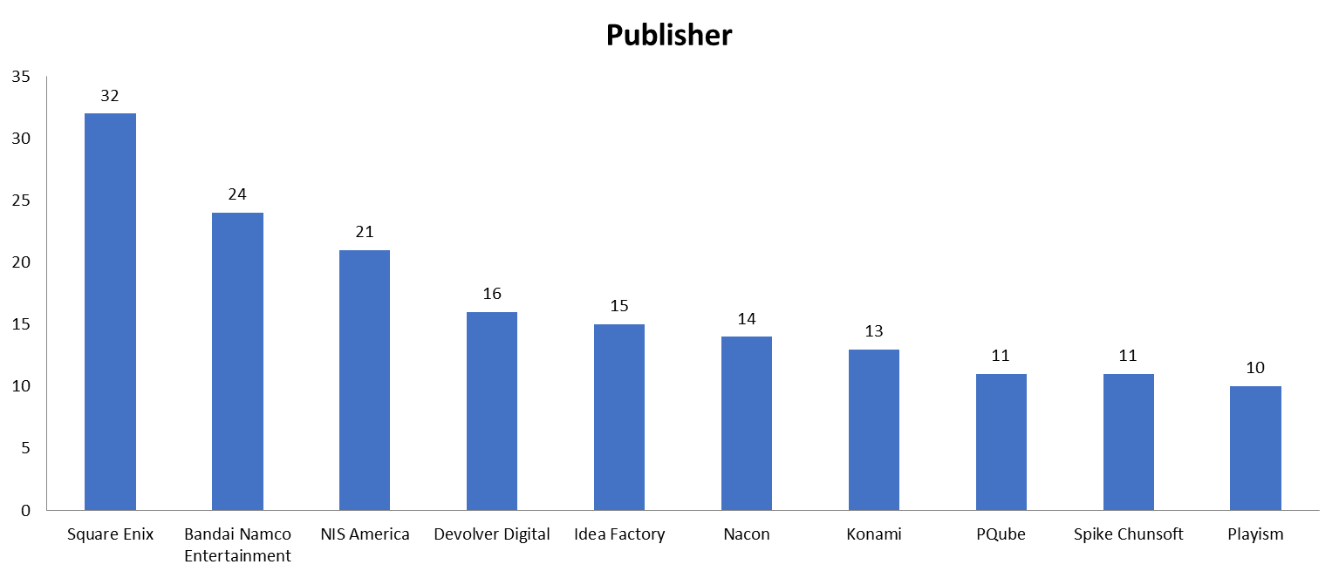
Publisher (Top 10)

Slide 11

Missing Data
After a thorough review, we are pleased to report that there is no missing data in the dataset. This means that all 987 observations are complete and can be used for analysis, providing a robust foundation for our findings and conclusions.

Slide 12

Conclusion
The most popular platform among the games released in 2022 is the Nintendo Switch.
Adventure and Action games are the most common genres among the games released in 2022.
The developer and publisher with the most releases in 2022 is Square Enix.
The data shows a strong correlation between the popularity of a platform and the number of releases on that platform.

Slide 13

Thank you

